Slide 1

Prompt Engineering
1811 RIT PE Team 3A

Slide 2
Team
Member’s Name | Member’s Email ID
Allam Sridhar | allamsridhar2001@gmail.com
Abdullah Imran | abdullahimranarshad@gmail.com
John Syllah | johnsyllah2003@gmail.com
Rajyavardhan Chauhan | rajyavardhanchauhan01@gmail.com
Kuntal Tarwatkar | tarwatkark63@gmail.com
Kamogelo Tele | kamogelotele@gmail.com
Ravi Teja Bhukya | ravitejabhukya35@gmail.com

Slide 3
Overview
Introduction
Research Methodology
Key Findings
Comparative Analysis
Recommendations
Conclusion

Slide 4

Introduction

Slide 5
Introduction (1/2)
Large Language Models (LLMs):
Process and generate text.
Excel at tasks like translation, summarization, and creative writing.
Multimodal Models:
Process and generate multiple data types (text, images, audio, video).
Enable more complex tasks like image captioning, video analysis, and virtual assistants.

Slide 6
Introduction (2/2)
ChatGPT:
Powerful LLM for text-based tasks.
Well-established and reliable platform.
Enables deep exploration of prompt engineering techniques.
Gemini:
Cutting-edge multimodal model.
Capable of understanding and generating text and images.
Ideal for innovative prompt engineering research, especially in multimodal scenarios.

Slide 7

2. Research Methodology

Slide 8
2. Research Methodology
Tool Selection: Analyzed usability, scalability, and features.
Prompt Testing: Conducted through tests on coding, creative writing, and multimodal prompts.
Evaluation Metrics: Accuracy, efficiency, and user experience.
By refining prompts, we compared their performance against less refined versions.
Assessed the models' strengths and limitations, identifying areas for future improvement.

Slide 9

3. Key Findings

Slide 10
3.1: Prompt Tests Results
Category | ChatGPT | Gemini
Coding | 4.69 | 4.66
Poems | 4.86 | 4.11
Images | 4.14 | 4.192
Analytical | 4.62 | 4.64
Conversation | 4.684 | 4.268
Summary | 4.475 | 4
Sentiment | 4.675 | 4.85
Ethics | 4.92 | 4.92
Total | 37.064 | 35.64

Slide 11
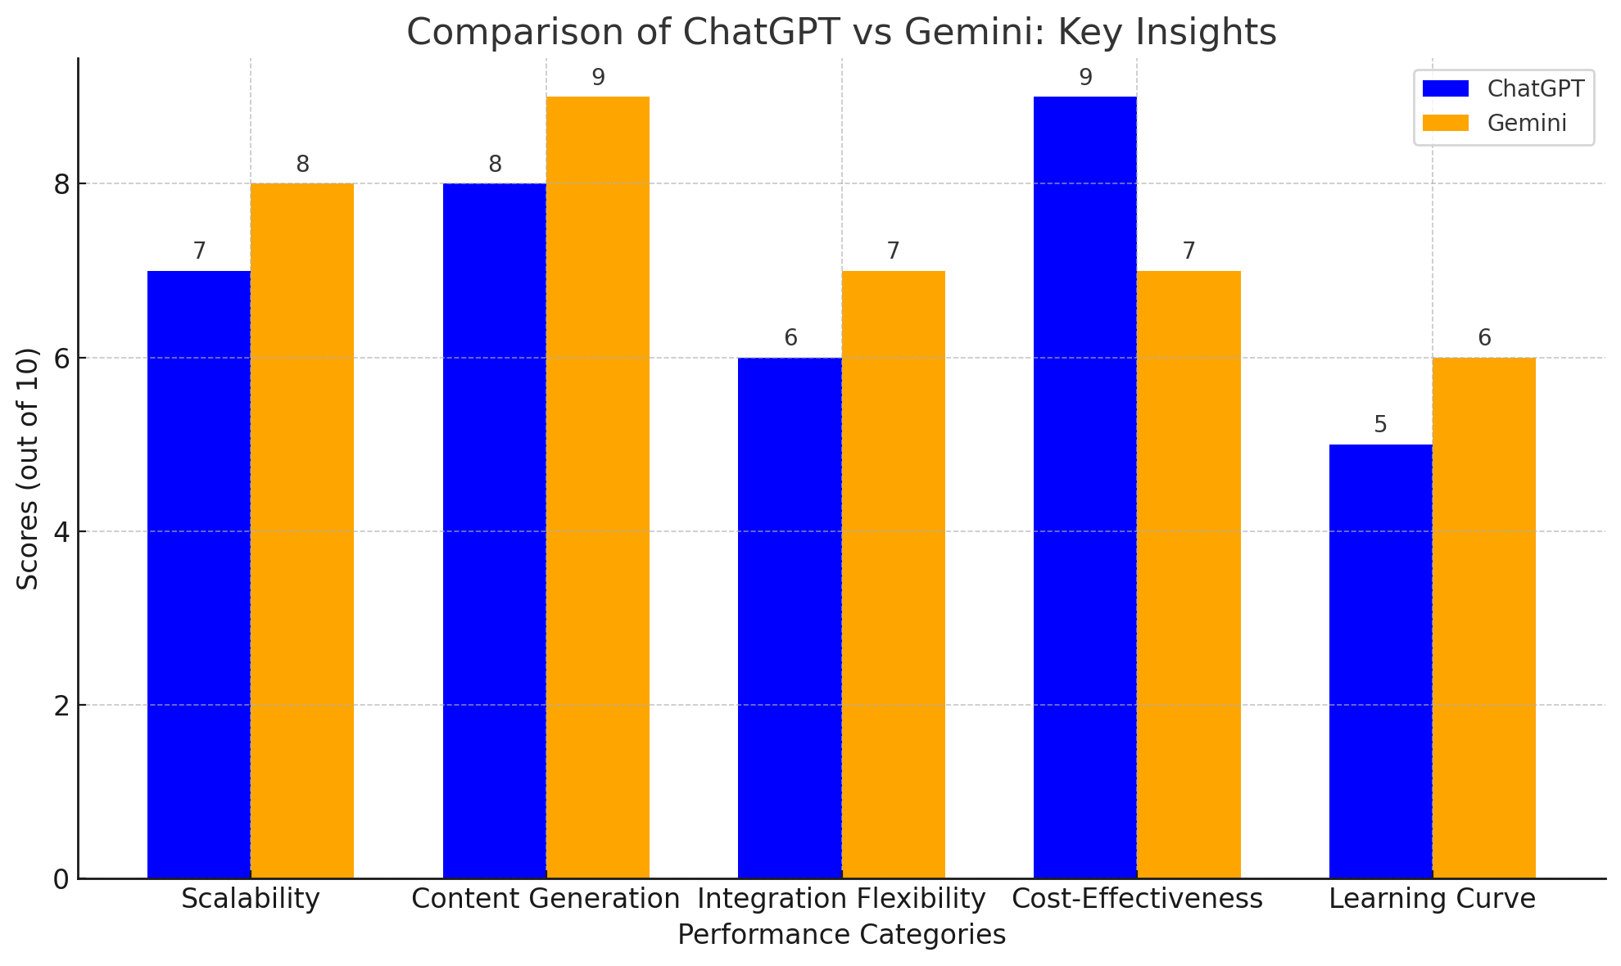
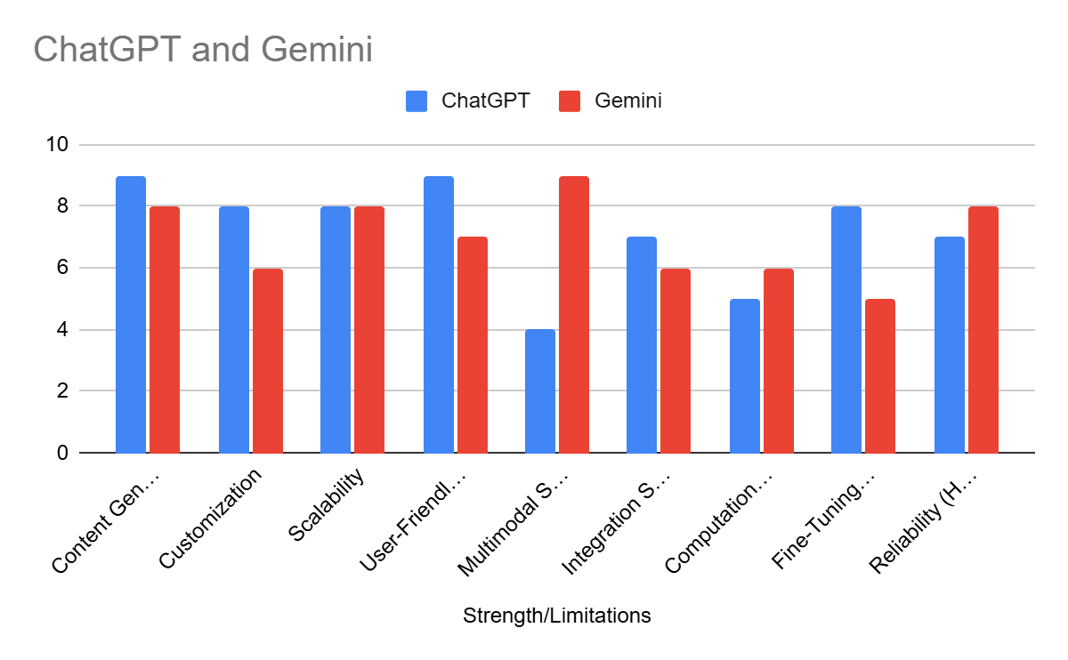

Slide 12
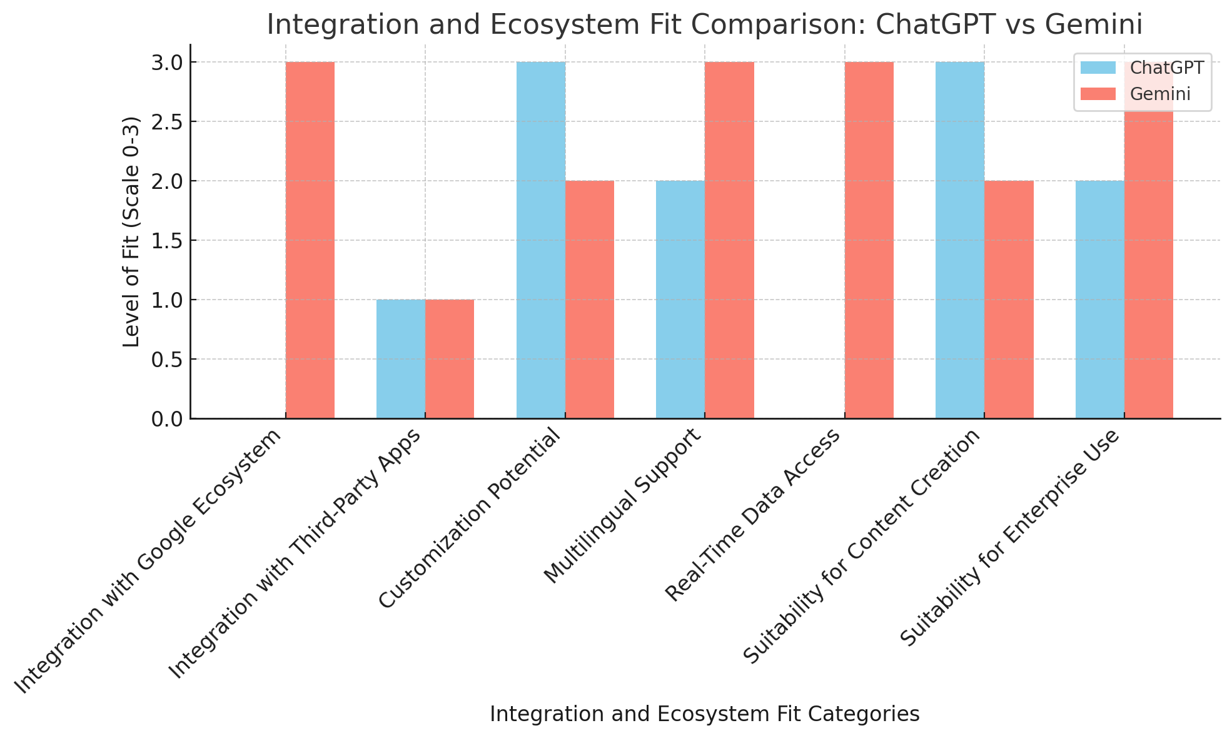
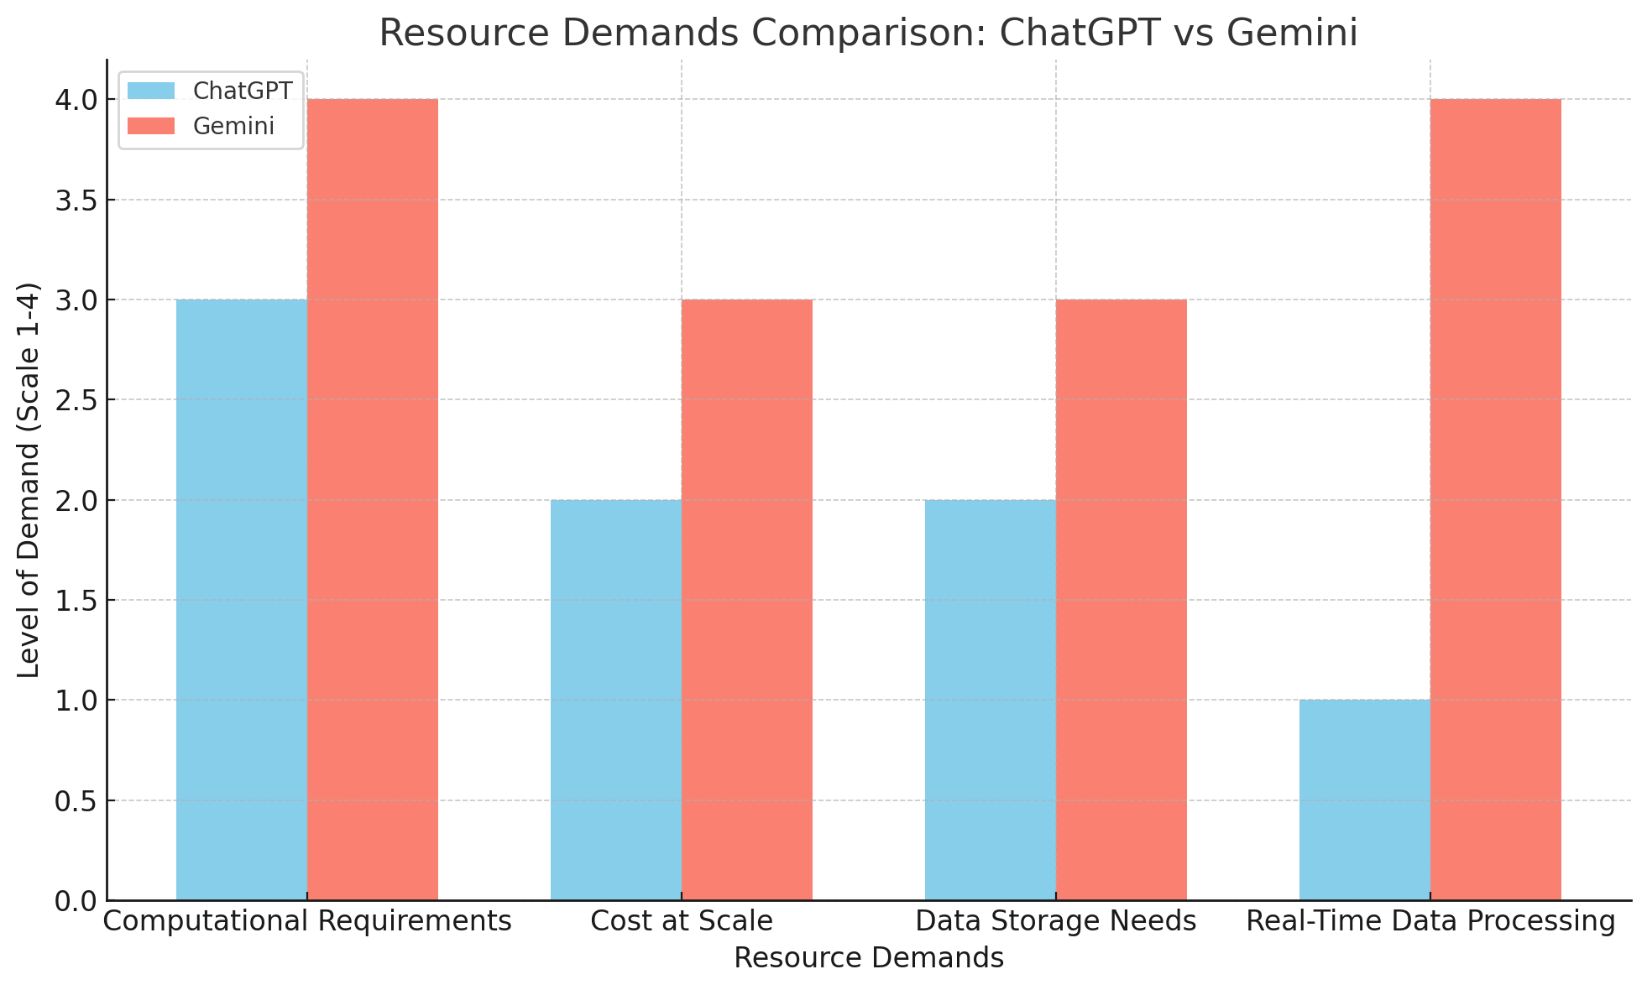

Slide 13

4. Comparative Analysis

Slide 14
4. Comparative Analysis (1/2)
Aspect | ChatGPT | Gemini
Developer | OpenAI | Google DeepMind
Multimodal Capability | Limited (text-focused; GPT-4 Vision adds images) | Fully multimodal (text, images, real-time data)
Customization | Extensive fine-tuning supported | Limited customization; pre-trained capabilities
Languages Supported | 20+ | 40+
Cost Efficiency | High | Moderate; resource-intensive for multimodal
Use Cases | Creative writing, customer support, education | Enterprise analytics, multimedia document processing
Challenges | Prone to hallucinations and biases | Higher computational demand; experimental features

Slide 15
4. Comparative Analysis (2/2)
Industry | ChatGPT | Gemini
Education | Personalized quizzes, summaries, explanations | Annotated diagrams, video explanations, interactive exercises
Healthcare | Patient triage, medical report summaries, health chatbots | Medical image interpretation, text-based diagnostics
Marketing & Advertising | Ad copy, SEO content, social media posts | Multimodal campaigns (text, images, videos)
Customer Support | Automated FAQ responses, troubleshooting guides | Visual support (screenshots, diagrams)
Creative Content Generation | Poetry, stories, screenplays, idea generation | Illustrated stories, multimedia content, conceptual designs

Slide 16

5. Recommendations

Slide 17
5. Recommendations (1/4)
Content Creation:
Leverage Chat GPT: Automate scriptwriting, text creation, and module structuring.
Utilize Gemini: Develop multimedia-rich content (infographics, animations, videos).
Optimize Content: Refine content for clarity, engagement, and user retention.
Collaborative AI: Combine ChatGPT and Gemini for efficient content production.

Slide 18
5. Recommendations (2/4)
Engagement Strategies:
Gamification: Implement challenges, badges, and leaderboards.
Real-Time Engagement: Use live polls, Q&A, and chat features.
Holistic Approach: Combine gamification and real-time engagement.
Monitor Engagement: Analyze user behavior and adjust strategies.

Slide 19
5. Recommendations (3/4)
Personalization:
Track User Behavior: Monitor engagement, activity patterns, and learning progress.
Personalize Learning: Adapt learning paths, feedback, and content.
Improve Retention: Predict disengagement and take proactive measures.
Monitor Long-Term Progress: Track key metrics and make data-driven decisions.

Slide 20
5. Recommendations (4/4)
Workflow Optimization:
Automate Tasks: Schedule sessions, send reminders, and generate reports.
Reduce Administrative Overhead: Free up staff for strategic tasks.
Enhance Accuracy: Minimize human error in scheduling and communication.
Increase Response Time: Ensure timely communication with users.

Slide 21

6. Conclusion

Slide 22
6. Conclusion
Prompt Engineering is Critical: Effective prompt design is essential for optimal AI performance.
AI, a Powerful Tool: While AI has advanced significantly, it's important to use it judiciously and be aware of its limitations.
Enhancing Learning with AI: Excelerate can leverage ChatGPT and Gemini to streamline tasks, spark creativity, and elevate user experiences through gamification.

Slide 23
Thank You

